Slide 1
CS312 Artificial Intelligence
Lecture # 06
HITEC University, Taxila
Mr. Mubashir Iqbal
Fall-2025

Slide 2
Lecture Content
Informed Search Algorithms - II:
Hill Climbing Search
Branch and Bound Technique
State Space Search - Eight Tile Puzzle Problem
Knowledge representation:
Introduction to Knowledge Representation (KR)
Propositional Logic in AI (Syntax, Equivalence and Rules of Inference)
First-Order Logic (FOL) - Predicate Logic & Quantifiers
Unification Algorithm in Artificial Intelligence with example.
Forward and Backward Chaining
Constraint Satisfaction Problems (CSP)

Slide 3
Hill Climbing Search

Slide 4
Hill Climbing Search
Hill Climbing is a heuristic-based, local search algorithm used in Artificial Intelligence. It continuously moves in the direction of increasing value (or decreasing cost), similar to climbing a hill until it reaches the top.
It is an informed search algorithm because it uses a heuristic evaluation function h(n) to decide which neighboring state is better.
Definition-2
Hill Climbing Search is a local search algorithm that starts with an initial solution and iteratively moves to a neighboring state with a better heuristic value, aiming to reach the optimal solution.

Slide 5

Hill Climbing Search
Key Characteristics
Uses heuristic to evaluate next states
Moves only to better states
Does not maintain a search tree
Works locally (neighbor examination)
Fast and memory efficient
Can get stuck in local optima
How Hill Climbing Works (Steps)
Start with an initial state
Evaluate all neighboring states
Choose the neighbor with the best heuristic
Move to that neighbor
Repeat until:
No better neighbor exists (local maximum)
A solution is found

Slide 6
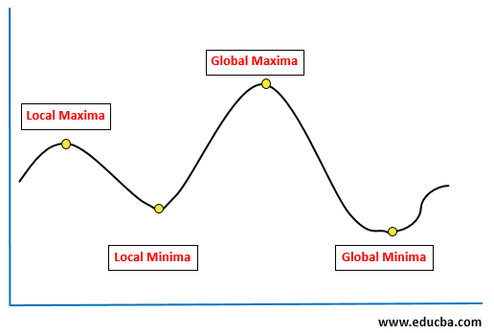
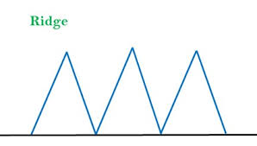
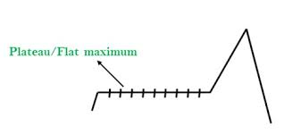
Hill Climbing Search
Problems with Hill Climbing
Hill Climbing can get stuck in:
a) Local Maxima
A peak that is lower than the global maximum.
b) Plateaus
Flat area - no direction gives improvement.
c) Ridges
Narrow peaks; algorithm struggles to find the path.

Slide 7
Hill Climbing Search
Types of Hill Climbing
a) Simple Hill Climbing
Moves to the first better neighbor (not necessarily the best)
b) Steepest-Ascent Hill Climbing
Evaluates all neighbors and picks the best
c) Stochastic Hill Climbing
Randomly selects one of the better neighbors
Useful when the search space is large

Slide 8
Hill Climbing Search
Advantages
Very fast
Low memory usage
Easy to implement
Good for optimization problems
Disadvantages
Gets stuck in local maxima
Struggles with plateaus
No backtracking
May not find global optimal solution
Real-World Applications
Robotics path optimization
Machine learning parameter tuning
Scheduling problems
Game AI strategies

Slide 9
Example 1
Start from A, Neighbors of A:
B → h=8
C → h=10
Pick the best neighbor: C (10), Move to C
At C, Neighbors of C:
A → h=5 (worse)
D → h=7 (worse)
G → h=12 (better)
Pick the best neighbor: G (12), Move to G
At G, Neighbors of G:
C → h=10 (worse)
There is no neighbor with a higher heuristic value. Stop! Reached a peak.
Path chosen by Hill Climbing:
A (5) → C (10) → G (12)
G (12)
Heuristic Knowledge
Node | h(n)
A | 5
B | 8
C | 10
D | 7
G | 12
C (10)
D (7)
A (5)
B (8)

Slide 10
Branch and Bound Technique

Slide 11
Branch and Bound Technique
Branch and Bound is a problem-solving technique used in Artificial Intelligence to find the best possible solution from many possible solutions, without checking every option fully.
Basic Idea
Branch → You expand (branch out) different possible paths or solutions.
Bound → You calculate a cost or bound for each path. The bound tells you whether this path can still lead to the best solution.
Prune (Cut off) → If a path is already too costly, or cannot give a better solution, then do not explore it further.
This saves time, memory, and avoids exploring useless paths.

Slide 12
Branch and Bound Technique
Application of this Algorithm
Shortest path problems
Traveling Salesman Problem (TSP)
Scheduling
Optimal search in graphs
Game tree exploration
Why is it called “Branch and Bound”?
Branch = Try different branches of the solution tree
Bound = Use cost limits (bounds) to stop exploring bad branches
Types of Branch and Bound Searches
DFS Branch and Bound
BFS Branch and Bound
Best-First Branch and Bound

Slide 13
Branch and Bound Technique
How It Works (Very Simple Steps)
1. Start from root node (initial state).
2. Branch out all possible next moves.
3. For each move, compute a “cost bound” Example: distance so far, or time, or heuristic value.
4. Always choose the path with the lowest cost bound to explore next.
5. If a path becomes more costly than the best solution found → CUT IT OFF.
6. Continue until you reach the optimal solution.
Features
Better than BFS or DFS for optimization problems
Ensures optimal solution
Uses cost constraints to prevent unnecessary search
Saves computational effort

Slide 14
Traveling Salesman Problem (TSP)

Slide 15
Traveling Salesman Problem (TSP)
A salesman must visit all cities exactly once and return to the starting city, while minimizing the total travel cost (distance/time/money).
Goal
Find the shortest possible tour that visits all cities once and returns to the start.
Why is it important?
It appears in logistics, robot path planning, circuit design, transportation, delivery routing, and DNA sequencing.
It is a NP-Hard (nondeterministic polynomial time) problem → exact solution becomes extremely slow when the number of cities increases.

Slide 16
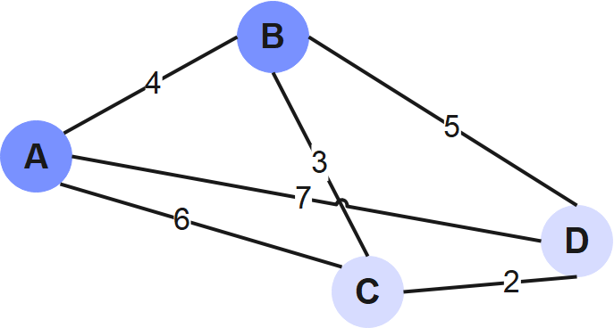
Traveling Salesman Problem (TSP)
From | To | Cost
A | B | 4
A | C | 6
A | D | 7
B | C | 3
B | D | 5
C | D | 2
Calculate All Possible Tours
There are (4-1)! = 6 possible tours (because TSP tours treat ABCD and BCDA as same cycle).
We start from A.

Slide 17
Traveling Salesman Problem (TSP)
Route 1: A → B → C → D → A = 4 + 3 + 2 + 7 = 16
Route 2: A → B → D → C → A = 4 + 5 + 2 + 6 = 17
Route 3: A → C → B → D → A = 6 + 3 + 5 + 7 = 21
Route 4: A → C → D → B → A = 6 + 2 + 5 + 4 = 17
Route 5: A → D → B → C → A = 7 + 5 + 3 + 6 = 21
Route 6: A → D → C → B → A = 7 + 2 + 3 + 4 = 16
From | To | Cost
A | B | 4
A | C | 6
A | D | 7
B | C | 3
B | D | 5
C | D | 2

Slide 18
Traveling Salesman Problem (TSP)
How TSP Relates to Branch and Bound?
TSP is perfect for Branch and Bound because:
Many possible tours
Many tours can be eliminated early
Bounding helps avoid unnecessary path exploration
Guarantees optimal result efficiently

Slide 19
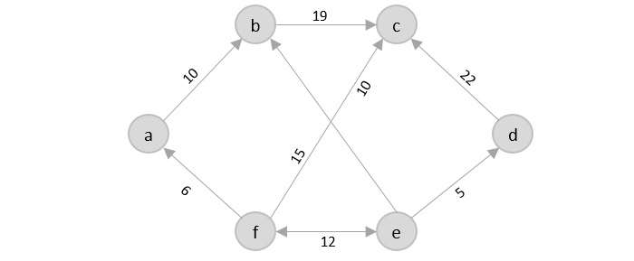
Question
Apply Traveling Salesman Problem (TSP), Treat this graph as un-directed graph

Slide 20
State Space Search - Eight Tile Puzzle Problem

Slide 21
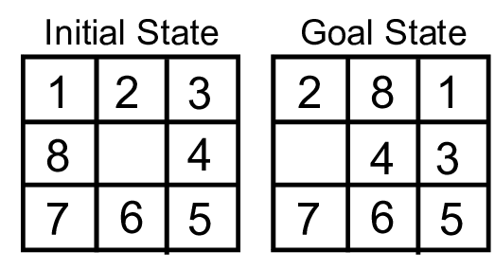
State Space Search
State Space Search is a fundamental AI problem-solving method used for finding a sequence of actions that leads from a Start State to a Goal State.
What Is a State?
A state is a specific situation or configuration of the problem.
Example (8-Puzzle):
State Space
The State Space is the set of all possible states that can be reached from the start state by applying legal actions.
Think of it as a map of all possible moves, including:
Start State
Intermediate States
Goal State
For the 8-Puzzle, the maximum state space = 9! (362,880 states).

Slide 22
State Space Search
State Space Representation
State space is represented as a search tree or graph:
Nodes → States
Edges → Actions that lead to new states
Root → Start State
Goal Node → Target configuration
How State Space Search Works (Process)
Start from initial state
Expand the node by applying all legal actions
Generate successor states
Choose the next state based on the algorithm (BFS, DFS, A*, etc.)
Continue until you reach the goal state

Slide 23
State Space Search
Components of State Space Search
Every State Space Search consists of:
(a) Initial State: Where the problem starts.
(b) Actions / Operators: Legal operations that change the state. Example: Move blank tile (UP / DOWN / LEFT / RIGHT).
(c) Successor Function: A function that generates new states from current state by applying actions.
(d) Goal Test: Checks if the state = desired final condition.
(e) Path Cost (optional): Cost of reaching the goal.
Used in Uniform Cost Search, A*, etc.

Slide 24
State Space Search
Real-Life Examples of State Space Search
Example 1: Navigation (Google Maps)
State = location
Operators = move to neighboring roads
Goal = destination
Algorithm = A* search
Example 2: Puzzle Solving (8-Puzzle, 15-Puzzle)
State = tile arrangement
Operators = tile moves
Example 3: Robot Path Planning
State = robot position
Goal = reach destination

Slide 25
State Space Search - Eight Tile Puzzle Problem
The Eight Tile Puzzle (also called 8-Puzzle) is a classic problem in Artificial Intelligence used to explain state-space search, heuristic search, and problem-solving algorithms.
It consists of:
A 3 × 3 board
8 numbered tiles (1 to 8)
1 empty space (blank)
The “Eight Tile Puzzle” can be solved using A* (A-star) or Best First Search (BFS) by treating it as a state-space search problem. The process involves defining the problem’s states, creating a heuristic function (like Manhattan distance) to estimate the cost to the goal, and then systematically exploring possible moves from the initial state until the goal state is reached.

Slide 26
State Space Search - Eight Tile Puzzle Problem
Why This Problem Is Important in AI
The 8-Puzzle teaches:
State space representation
Node expansion and branching
Problem formulation (state, goal, operators)
Searching vs. path cost
Heuristic design
Optimal vs. near-optimal solutions
Time & space complexity analysis
It is a standard benchmark for comparing search strategies.

Slide 27
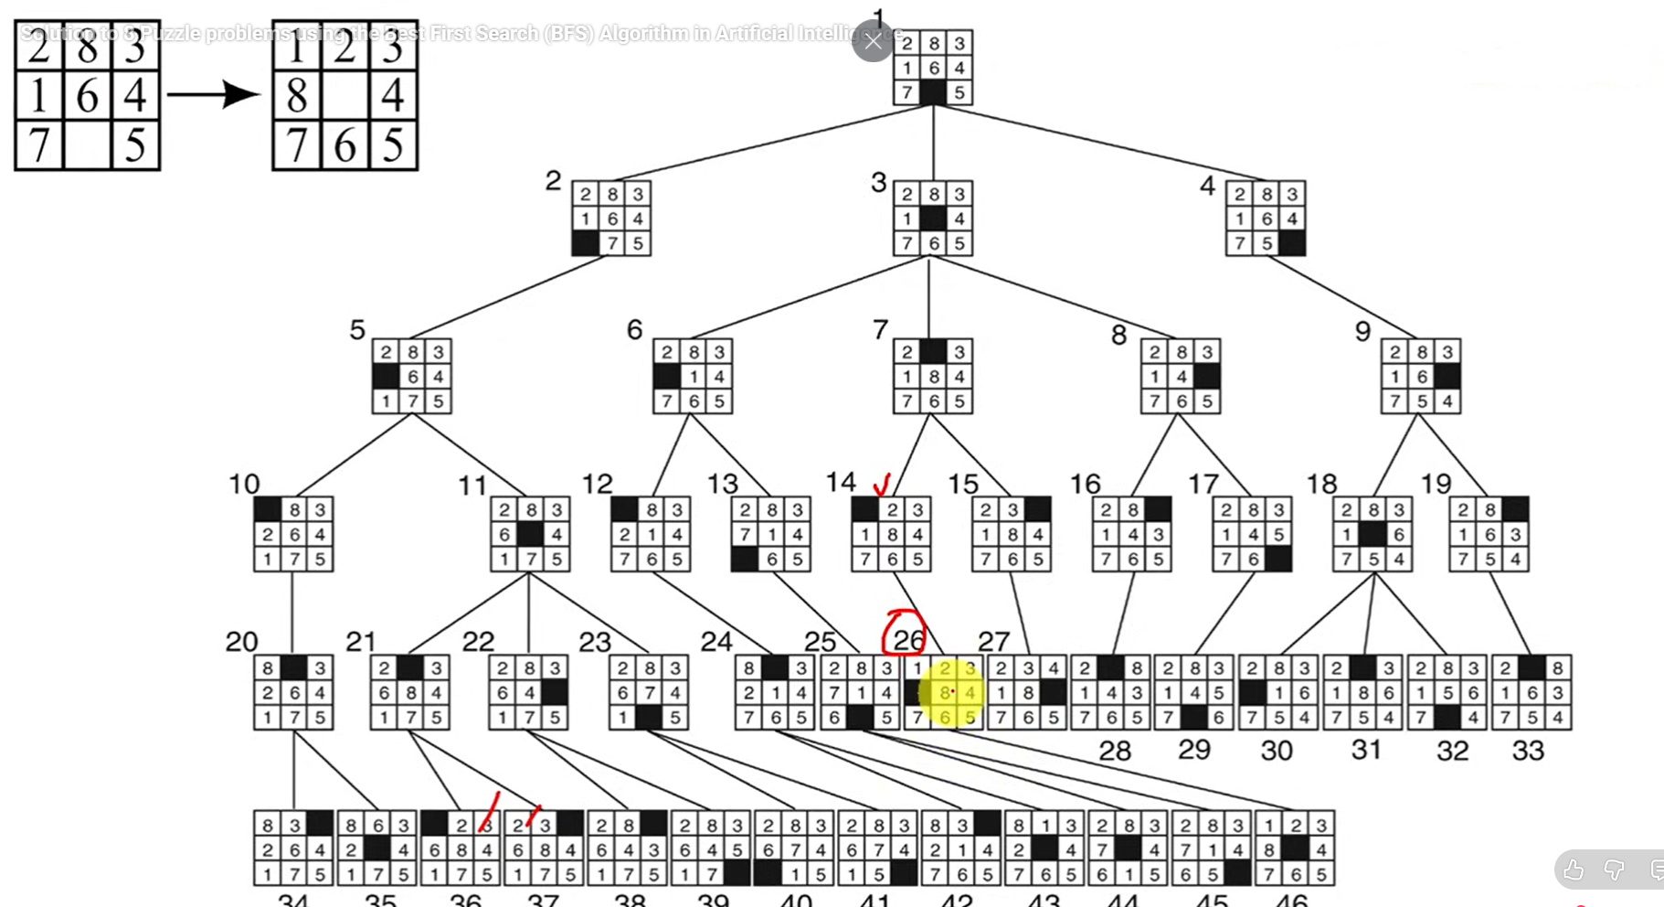
State Space Search - Eight Tile Puzzle Problem
Video Link: Solution to 8 Puzzle problems using the Best First Search (BFS) Algorithm in Artificial Intelligence

Slide 28
Knowledge Representation

Slide 29
Knowledge Representation (KR)
Knowledge Representation (KR) is a branch of Artificial Intelligence that focuses on how to store, organize, and represent knowledge in a way that a computer (AI system) can understand, reason, and use it to make decisions.
In simple words:
KR = How to put human knowledge into a format that a machine can use.
Goals of KR
Make knowledge usable by machines
Allow reasoning (AI can derive new facts from known facts)
Organize knowledge efficiently
Model real-world problems
Handle incomplete, uncertain, or fuzzy knowledge

Slide 30
Knowledge Representation (KR)
Why Do We Need Knowledge Representation?
Humans understand things naturally, but computers do not. To make AI work intelligently, we must represent knowledge such as:
Facts
Rules
Relationships
Concepts
Procedures
Logic
KR makes it possible for machines to:
Understand a situation
Reason like humans
Solve problems
Answer questions
Make predictions

Slide 31
Knowledge Representation (KR)
Approaches of Knowledge Representation
These are the major KR techniques (covered later in detail):
1. Logical Representation (Propositional & Predicate Logic)
Uses logic, facts, and rules.
2. Semantic Networks
Graph-based representation using nodes and links.
3. Frames
Data structures with slots & values.
4. Production Rules
IF–THEN rules.
5. Ontologies
Hierarchical knowledge for domains (used in the Semantic Web).
6. Scripts
Represent real-world sequences of events.

Slide 32
Propositional Logic in AI
Propositional Logic is a logic system used in AI to represent facts about the world using simple statements (propositions) that are either True or False.
It helps an intelligent system to:
Represent knowledge in a structured way
Reason and make logical decisions
Derive new facts from known facts
Examples of propositions:
“It is raining” → True/False
“The robot is in room A” → True/False

Slide 33
Propositional Logic in AI
1. Syntax of Propositional Logic
Syntax defines how valid statements are formed.
Basic Components
Propositions / Variables: A, B, C … (represent facts)
Logical Connectives:
NOT (¬ or ~)
AND (∧)
OR (∨)
IMPLIES (→)
BICONDITIONAL (↔)
Parentheses: Used to group expressions e.g., (A ∧ B) → C

Slide 34
Propositional Logic in AI
2. Semantics (Meaning)
Semantics define how to determine Truth Values.
Example:
Let
A = “It is raining.” = True
B = “The ground is wet.” = True
Then
A ∧ B = True
A → B = True
A ∨ False = True

Slide 35
Propositional Logic in AI
3. Logical Equivalence
Two statements are equivalent if they always have the same truth value in all situations.
Common Equivalences
Double Negation: ¬(¬A) ≡ A
De Morgan’s Laws:
¬ (A ∧ B) ≡ ¬A ∨ ¬B
¬ (A ∨ B) ≡ ¬A ∧ ¬B
Implication Equivalence: A → B ≡ ¬A ∨ B
Contrapositive: A → B ≡ ¬B → ¬A
Biconditional: A ↔ B ≡ (A → B) ∧ (B → A)
These are useful for simplifying knowledge and reasoning in AI systems.

Slide 36
Propositional Logic in AI
4. Rules of Inference
Rules that help us deduce new facts from existing facts. Used heavily in AI reasoning engines (expert systems, theorem provers).
Common Rules of Inference:
1. Modus Ponens (Most important)
2. Modus Tollens
3. And-Introduction
4. And-Elimination
5. Or-Introduction
6. Resolution (Very important in AI)

Slide 37
First-Order Logic (FOL)

Slide 38
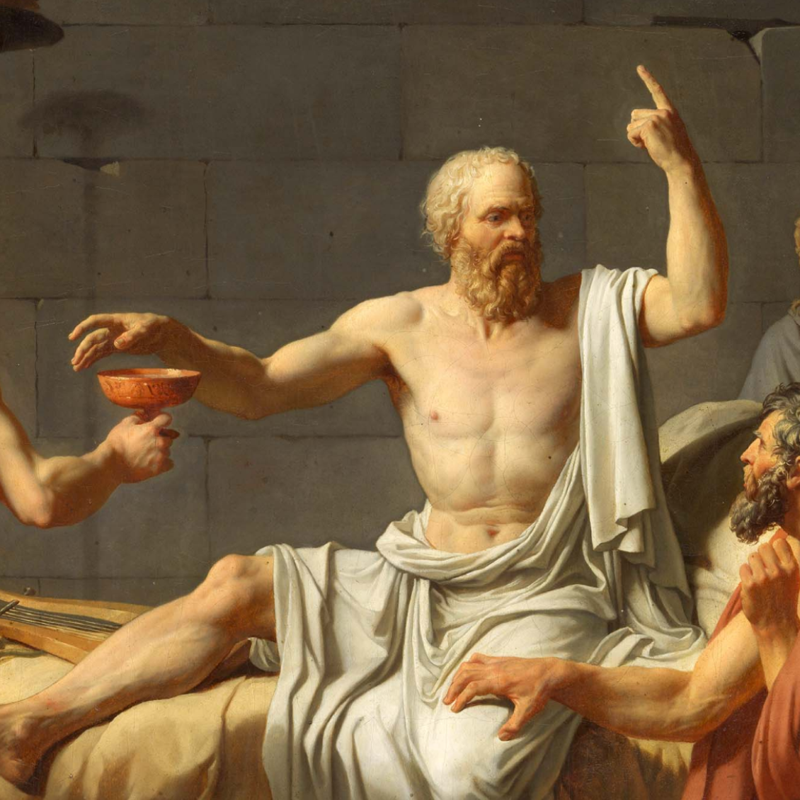
First-Order Logic (FOL)
First-Order Logic (FOL), also called Predicate Logic, is a more powerful logic system than propositional logic. It allows AI systems to represent objects, their properties, and relationships between objects.
Propositional logic can only say: “Humans are mortal” (True/False)
FOL can say:
✔ “All humans are mortal”
✔ “Socrates (Greek philosopher) is a human”
✔ “Therefore, Socrates is mortal”
This ability makes FOL essential in knowledge representation, expert systems, reasoning, and natural language processing.

Slide 39
First-Order Logic (FOL)
Components of First-Order Logic
1. Constants: Specific objects, - Socrates, Pakistan, Alice, 5
2. Variables: Symbols that refer to unspecified objects, - x, y, z
3. Predicates: Properties or relationships, - Human(x), Mortal(x), Loves(Alice, Bob)
4. Functions: Map objects to other objects, Father(x), Max(a, b)
5. Logical Connectives: Same as propositional logic: ∧, ∨, ¬, →, ↔
6. Quantifiers: The most powerful addition in FOL.

Slide 40
First-Order Logic (FOL)
Why FOL Is Important in Artificial Intelligence
FOL allows AI to:
Represent complex knowledge
Perform logical reasoning
Infer new facts
Understand natural language
Build expert systems
Represent hierarchical knowledge (ontology)
Propositional logic = simple, FOL = expressive, intelligent reasoning

Slide 41
First-Order Logic (FOL)
Advantages of First-Order Logic
More expressive than propositional logic
Can represent classes, objects, and relations
Supports reasoning with universal rules
Useful in planning, robotics, NLP, and knowledge systems
Limitations or Disadvantages
Harder to compute / more expensive
Reasoning can become very slow for large systems
Needs well-defined domain knowledge

Slide 42
Unification Algorithm in AI

Slide 43
Unification Algorithm in AI
Unification is the process of making two logical expressions identical by finding a suitable substitution for their variables.
It is used heavily in:
First-Order Logic (FOL)
Predicate Logic
Prolog / Logic Programming
Inference (Resolution Rule)
Automated Theorem Proving
In simple words: Unification tries to match two expressions by replacing variables with constants or other variables.

Slide 44
Unification Algorithm in AI
Why Unification is Important
AI systems need to:
Compare statements
Match patterns
Draw logical conclusions
The unification algorithm allows AI to determine whether two predicates can be made the same and if yes, how.
How Unification Works: Two expressions can be unified if:
They have the same predicate name
They have the same number of arguments
Their arguments can be made identical by substitution
A substitution is written like:
{ x / Ali } → replace x with Ali
{ y / z } → replace y with z
Unify P(x, y) and P(Ali, z) → { x / Ali, y / z }

Slide 45
Forward and Backward Chaining

Slide 46
Forward and Backward Chaining
In Knowledge-Based Systems (especially Expert Systems), we use inference methods to derive new knowledge from known facts and rules.
Two key reasoning methods are:
Forward Chaining (Data-Driven Reasoning)
Backward Chaining (Goal-Driven Reasoning)

Slide 47
Forward and Backward Chaining
1. Forward Chaining: Forward chaining starts from known facts and applies rules to derive new facts until the goal is reached.
“What can I conclude from what I know?”
It is Data-Driven
Because it moves from facts → conclusions.
Example: Given Rules (IF–THEN rules):
R1: IF A AND B THEN C
R2: IF C THEN D
R3: IF D AND E THEN F
Initial Facts: A, B, E
Process:
From A & B, rule R1 fires → produce C
Now we have C → rule R2 fires → produce D
Now we have D and E → rule R3 fires → produce F
Final Goal Achieved: F

Slide 48
Forward and Backward Chaining
2. Backward Chaining: Backward chaining starts from a goal and works backward to determine whether existing facts support it.
“What do I need to prove to reach my goal?”
It is Goal-Driven
Because it moves from goal → check supporting facts.
Backward Chaining Example
Goal: Is F true?
Same Rules:
IF A AND B THEN C
IF C THEN D
IF D AND E THEN F

Slide 49
Forward and Backward Chaining
Start from the goal: F
To prove F, rule R3 requires: D & E
We check if E is known → yes. We need to prove D → requires C (from R2).
To prove C → requires A and B (from R1).
We check:
A → known
B → known
So we can conclude:
A & B → C, C → D, D & E → F
Goal Proven!

Slide 50
Forward and Backward Chaining
S/No | Feature | Forward Chaining | Backward Chaining
1. | Direction | Facts → Goal | Goal → Facts
2. | Driven by | Data | Goal
3. | Best for | Large datasets, rule triggering | Specific goal queries
4. | Efficiency | Can generate many irrelevant facts | More efficient for single goals
5. | Example use | Diagnosis systems, automation | Goal checking, logic proofs

Slide 51
Constraint Satisfaction Problems (CSP)

Slide 52
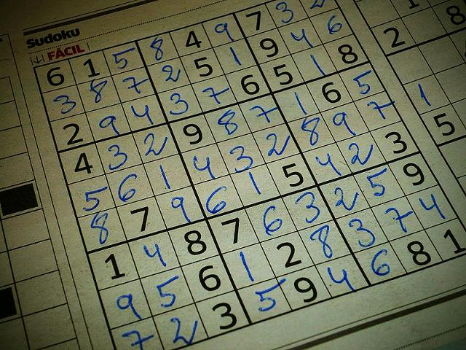
Constraint Satisfaction Problems (CSP)
In Artificial Intelligence, a Constraint Satisfaction Problem (CSP) is a problem where:
You have a set of variables
Each variable has a set of possible values (domains)
You have constraints that restrict which combinations of values are allowed
A solution to a CSP is an assignment of values to all variables such that all constraints are satisfied.
Examples of CSP
1. Map Coloring Problem: Assign colors to regions of a map so that no two adjacent regions have the same color.
Variables → Regions
Domain → {Red, Green, Blue}
Constraints → Adjacent regions must differ
2. Sudoku Puzzle: Fill a 9×9 grid so that:
Rows contain digits 1–9
Columns contain digits 1–9
3×3 subgrids contain digits 1–9

Slide 53
Constraint Satisfaction Problems (CSP)
Components of a CSP
1. Variables (X)
These are the elements we need to assign values to. Example: X = {A, B, C}
2. Domains (D)
Each variable has a set of possible values. Example: A ∈ {1, 2, 3} B ∈ {1, 2, 3} C ∈ {1, 2, 3}
3. Constraints (C)
Restrictions on variables. Example: A ≠ B B < C
A valid solution must satisfy all constraints.

Slide 54

Not included in Syllabus
If you were taking a nap, wake up… the lecture is over!

Slide 55

Recap
Informed Search Algorithms - II:
Hill Climbing Search
Branch and Bound Technique
State Space Search - Eight Tile Puzzle Problem
Knowledge representation:
Introduction to Knowledge Representation (KR)
Propositional Logic in AI (Syntax, Equivalence and Rules of Inference)
First-Order Logic (FOL) - Predicate Logic & Quantifiers
Unification Algorithm in Artificial Intelligence with example.
Forward and Backward Chaining
Constraint Satisfaction Problems (CSP)

